Slide 1
Urkund Introduction
History, Philosophy, Operations

Slide 2
4,000 customers in 76 countries

Slide 3
Urkund since 2000
2019
Awarded India nationwide tender. To provide 1,000 universities
Upper secondary schools in Sweden like Bromma Gymnasium were the first customers
2000
2004
2008
2012
2016
2020
Urkund was founded by educators from Uppsala University
2005
First foreign customer in France HEC
2018
Procuritas acquires Urkund
Customers in 60 countries

Slide 4
WHY DO INSTITUTIONS CHOOSE URKUND?
Ease of use
The report
Integrations
Smooth workflow
Email submissions
Price
Support & customer focus
System stability
Effective
Low rate of false positives

Slide 5
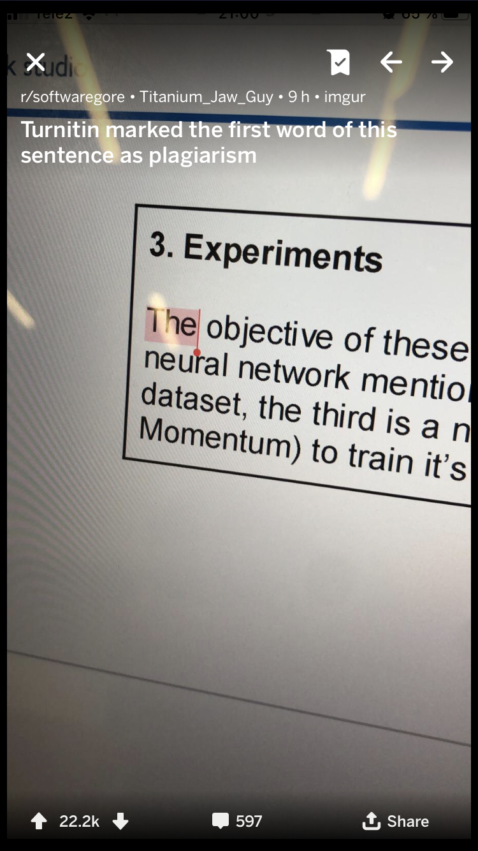

Slide 6
“
Urkund’s mission is to enhance education worldwide
VALUES
Urkund does not sell licence to anyone with a credit card (minimize the risk of putting the product in the hands of a ghost writer).
Fairness of education
“Plagiarism checkers are only showing the text similarity, they do not show the level of, or severity of plagiarism.”

Slide 7
Urkund from a business perspective
#2 globally
Solid financials and strong growth of +25 % in 2016, 2017, and 2018
Very low churn rate
New owners in February 2018, Procuritas (a Swedish PE-firm) → new era for Urkund’s journey
5-year plan in place focusing on growth and product development
Subscription-based cloud-solution with low churn rate. In-house development
Trippled the number of staff with a focus on management, sales, and digital marketing
Increased investment and resources in product development

Slide 8
Automated and scalable - 2 steps to analysis
SUBMISSIONS:
ANALYSIS REPORT
INTERNET
INTEGRATIONS
Web Pages
Student Material
Content from Public and Proprietary Sources
Textbooks
Scholarly Journals & Periodicals
EMAIL
INTERNAL DATABASE
UPLOAD
INFERENCE ENGINE
INDEXED MATERIAL
~3 min process from submission

Slide 9
Plagiarism – a global challenge
Plagiarism:
Digitalization – easy to plagiarise
Ghost writing - essay mills
Fake news
Legal problem
Knowledge and innovation repressive
Academic integrity
Urkund:
Promotes original thinking
Safeguarding academic integrity
Freeing up time for educators
Helping educators improve education quality

Slide 10
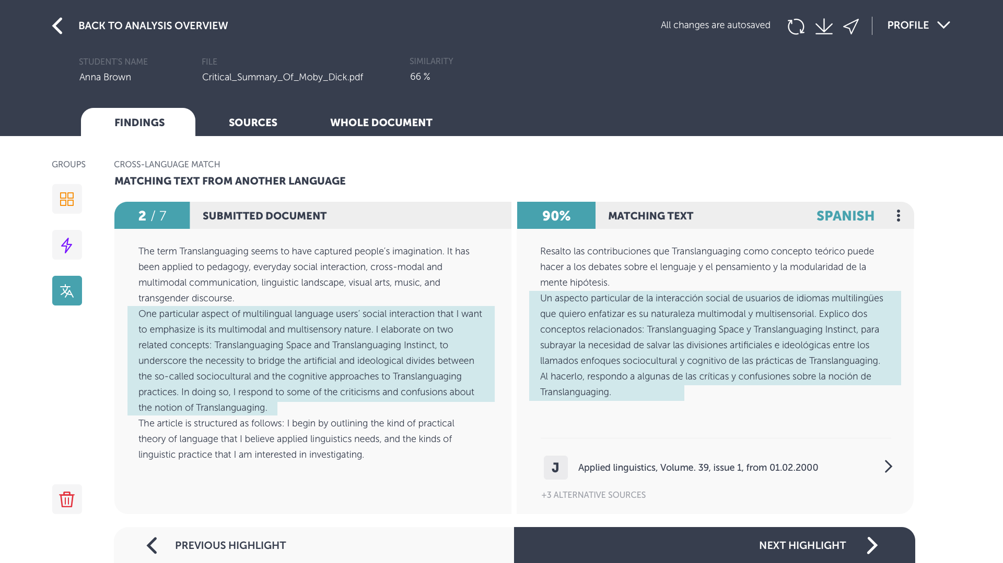
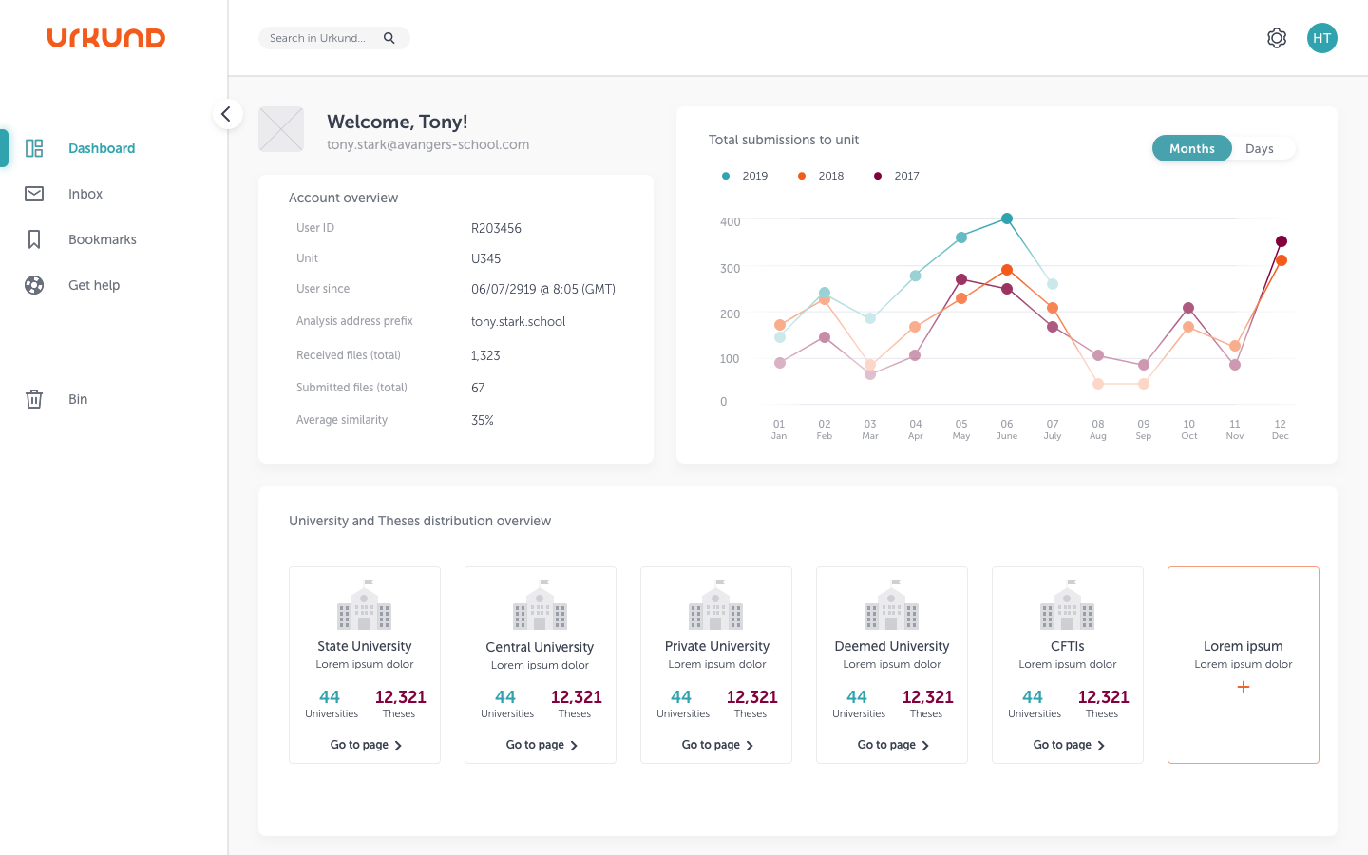
Product roadmap
Features
Cross-language detection
Author recognition
Content
Paid (Publisher journals)
Crawlers (Open access)
User interface
Analysis report, View 7
Administration interface, URSA
Integrations
API 2.0

Slide 11
Seamless integration is highly valued

Slide 12
Sales – partners are key in Urkund strategy
We want to collaborate with you!
Head of Sales + BENELUX: Menno Njissen
UK & IE, Higher Education: Cecilia Vahlin
UK & IE, K12: James Lankester
DACH: Ole Neumann
Nordics & Baltics: Neil Walker
Spain: Eric Johansson Salazar-Sandoval
North America: Eric Gibbs
Head of Global Expansion, Asia, Rest of Europe: Henning Säll
Latin America: Rômulo Borges Viana
Middle East & Africa, Oceania: Linnea Rydberg

Slide 13
Thank you!

