Slide 1
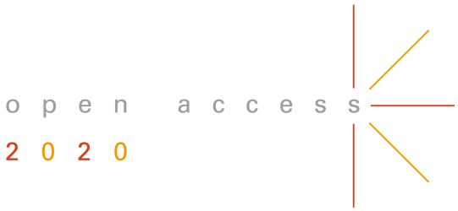

Accelerating the transition to Open Access
The global OA2020 Initiative
18 March 2019│ EIFL webinar
Colleen Campbell
Open Access 2020 Initiative │ Max Planck Digital Library
@oa2020ini
Notes:
Understand the relevance of OA publishing
Stockholm University
Number of titles
Monitor and analyze your publication and financial data
Norway example (refers to Elsevier)
Engage stakeholders at all levels
UC
Prepare a publisher negotiation strategy
MPDL big 3 are in normalized for 100%
MPDL data
Example from netherlands, ie RSC – step back from an agreement and document for alternative access routes (failure must be an option)
Leverage transformative agreements
MIT clause
Refer to ESAC (workshop – discussion of springer compact)
Collaborate and communicate
ESAC
LIBER and EUA
OA2020
OpenAPC
marketing

Slide 2
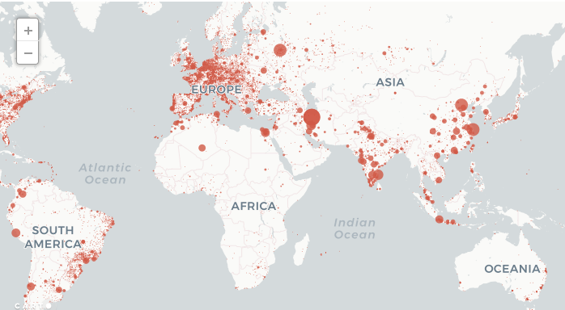
Effects of the subscription paywall
doi:10.1126/science.aaf5664
Notes:
As Patron Demand for Digital Services upward trajectory (as Louise showed us yesterday in the graph). In past focused on access to content, but now think about “access” in a wider perspective.
Think of text mining (we can offer the technology, but if we cannot interrogate the body of content behind paywalls, missing a huge piece of knowledge), digital humanities, digital use and reuse of scholarship
Want to advance open scholarship BUT researchers want to publish in the journals they know and trust
Help academic staff make sense of what is happening and navigate scholarly communications.
Need to be PROACTIVE
We cannot stand still, we need to be anticipating
Subscriptions have no place in the digital world
Today we demand everything immediately, fast-paced, everything at our fingertips. But science—most important—is hidden from us.
Capabilities of using research in new ways with technology, but in order to articles to be published they sign away the rights…have to pay again to use the fruits of their own research.
Server log data for the website Sci-Hub from September 2015 through February paint a revealing portrait of its users and their diverse interests. Sci-Hub had 28 million download requests, from all regions of the world and covering most scientific disciplines.

Slide 3
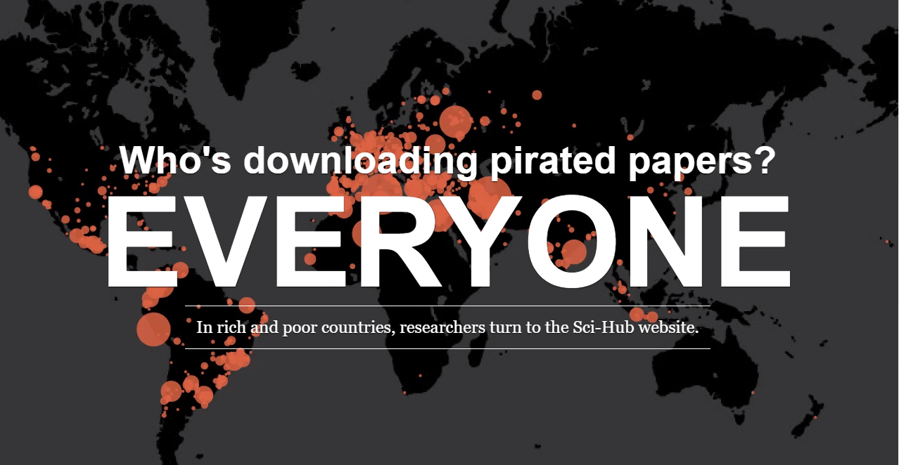
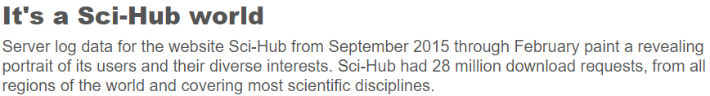
Paywall access does not meet the
needs of our researchers
doi:10.1126/science.aaf5664
Notes:
As Patron Demand for Digital Services upward trajectory (as Louise showed us yesterday in the graph). In past focused on access to content, but now think about “access” in a wider perspective.
Think of text mining (we can offer the technology, but if we cannot interrogate the body of content behind paywalls, missing a huge piece of knowledge), digital humanities, digital use and reuse of scholarship
Want to advance open scholarship BUT researchers want to publish in the journals they know and trust
Help academic staff make sense of what is happening and navigate scholarly communications.
Need to be PROACTIVE
We cannot stand still, we need to be anticipating
Subscriptions have no place in the digital world
Today we demand everything immediately, fast-paced, everything at our fingertips. But science—most important—is hidden from us.
Capabilities of using research in new ways with technology, but in order to articles to be published they sign away the rights…have to pay again to use the fruits of their own research.
Server log data for the website Sci-Hub from September 2015 through February paint a revealing portrait of its users and their diverse interests. Sci-Hub had 28 million download requests, from all regions of the world and covering most scientific disciplines.

Slide 4
Scholarly publishing today
Propping up an outdated and dysfunctional system
LIBRARIES
6
PUBLISHERS

Slide 5



For the past 15 years, OA strategies were based on forcing researchers to change practice
Poli-cies
Reposi-tories
OA Jour-nals
Publi-
cation funds
Man-dates
R
e
s
e
a
r
c
h
e
r
Notes:
Today, the International Society for Scientometrics and Informetrics (ISSI) announces the launch of the new journal Quantitative Science Studies (QSS), published by MIT Press. The editorial board of QSS consists of the members of the former editorial board of Journal of Informetrics (JOI), an Elsevier journal. The members of the editorial board of JOI, which include CWTS researchers Nees Jan van Eck, Anthony van Raan, and Paul Wouters, have unanimously resigned and have moved to QSS. An important reason for the resignation is Elsevier’s lack of support for the Initiative for Open Citations (I4OC). Disagreements about journal ownership and open access policies have played a role as well.

Slide 6
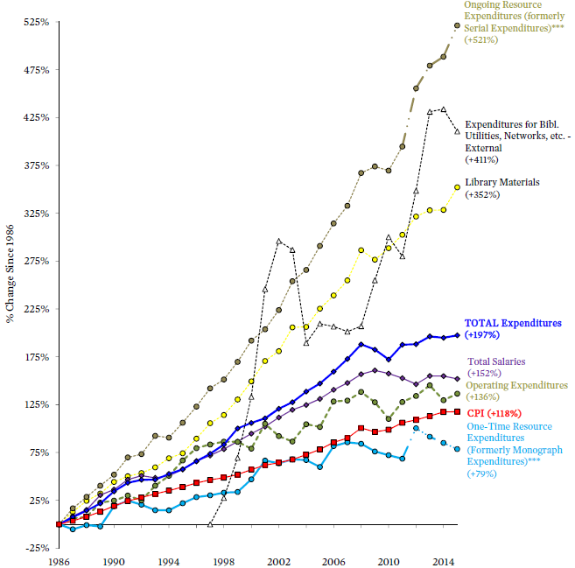

In the meantime, our money stays tied up
in big deal subscription packages
ARL Statistics 2014-15
Notes:
Input graph showing subscription expenditures
This is being reactive, it is investing in resources…not being PROACTIVE

Slide 7
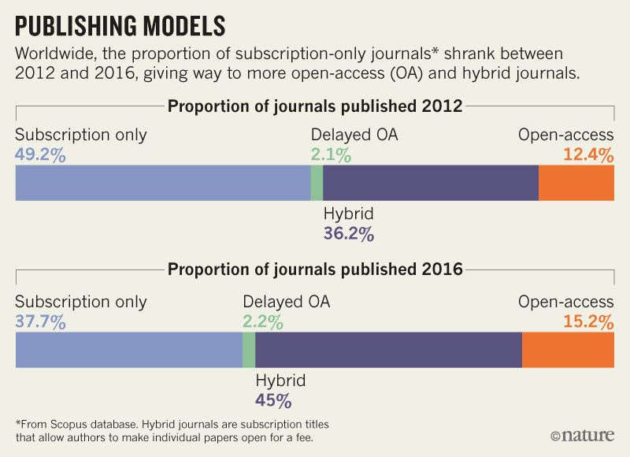
And progress to OA is too slow
Notes:
As Patron Demand for Digital Services upward trajectory (as Louise showed us yesterday in the graph). In past focused on access to content, but now think about “access” in a wider perspective.
Think of text mining (we can offer the technology, but if we cannot interrogate the body of content behind paywalls, missing a huge piece of knowledge), digital humanities, digital use and reuse of scholarship
Want to advance open scholarship BUT researchers want to publish in the journals they know and trust
Help academic staff make sense of what is happening and navigate scholarly communications.
Need to be PROACTIVE
We cannot stand still, we need to be anticipating
Subscriptions have no place in the digital world
Today we demand everything immediately, fast-paced, everything at our fingertips. But science—most important—is hidden from us.
Capabilities of using research in new ways with technology, but in order to articles to be published they sign away the rights…have to pay again to use the fruits of their own research.
Server log data for the website Sci-Hub from September 2015 through February paint a revealing portrait of its users and their diverse interests. Sci-Hub had 28 million download requests, from all regions of the world and covering most scientific disciplines.

Slide 8
We need to find a way to deliver open access to our researchers
Nature
PLOS
eLife
SCIENCE
CELL
R
e
s
e
a
r
c
h
e
r
Notes:
As Patron Demand for Digital Services upward trajectory (as Louise showed us yesterday in the graph). In past focused on access to content, but now think about “access” in a wider perspective.
Think of text mining (we can offer the technology, but if we cannot interrogate the body of content behind paywalls, missing a huge piece of knowledge), digital humanities, digital use and reuse of scholarship
Want to advance open scholarship BUT researchers want to publish in the journals they know and trust
Help academic staff make sense of what is happening and navigate scholarly communications.
Need to be PROACTIVE
We cannot stand still, we need to be anticipating
Subscriptions have no place in the digital world
Today we demand everything immediately, fast-paced, everything at our fingertips. But science—most important—is hidden from us.
Capabilities of using research in new ways with technology, but in order to articles to be published they sign away the rights…have to pay again to use the fruits of their own research.
Server log data for the website Sci-Hub from September 2015 through February paint a revealing portrait of its users and their diverse interests. Sci-Hub had 28 million download requests, from all regions of the world and covering most scientific disciplines.

Slide 9
Evidence that a cost-neutral transition to OA is possible on a global scale
7.6 Bn EUR
7.6 Bn
2M # articles
4 Bn
3800 EUR per article
3.6 Bn
> 2000 EUR per article
2M # articles
4.0 Bn EUR
http://hdl.handle.net/11858/00-001M-0000-0026-C274-7
Notes:
Lack of transparency

Slide 10
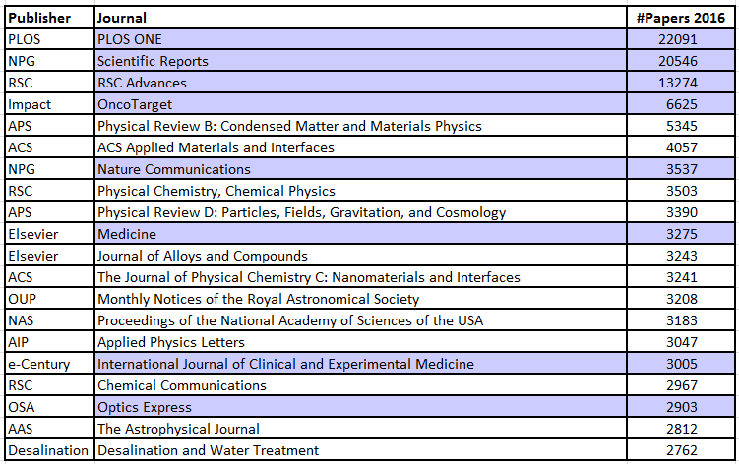
OA publishing is a growing market
(OA as of 2017)
20 largest journals, based on number of papers published in 2016. OA highlighted in grey.
MPDL analysis based on data from Web of Science.

Slide 11


That is a good thing, but…
OA publishing constitutes an unmonitored
and unchecked parallel revenue stream
for subscription publishers
+ 10
7.6 Bn EUR
+ 100
2M # articles
+ 1000
3800 EUR per article

Slide 12
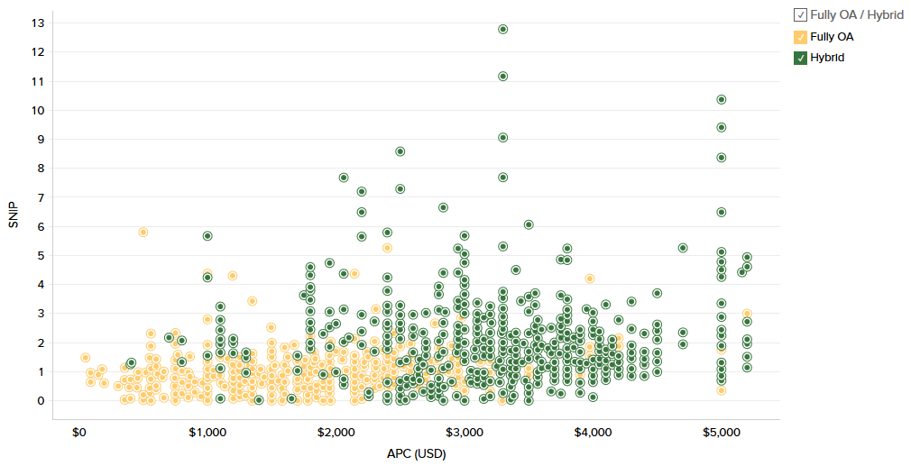
Risks of uncontrolled APCs
APC vs. SNIP for Publishers by Fully OA/Hybrid:
All publishers (2017-2018)
Average list APC
Fully OA: $1600
Hybrid: $2900
Average payment tracked by OpenAPC:
Fully OA: €1488
Hybrid €2445
With permission from Delta Think Open Access Data & Analytics tool. Analysis 15.09.2018

Slide 13
Publishing and access are two sides of the same coin
To unlock the system, both
money streams must be reined in.
subscriptions
OA publishing

Slide 14


Money must be shifted from subscriptions to open access publishing services
Subscription system
Open Access
$10bn
cash flow

Slide 15
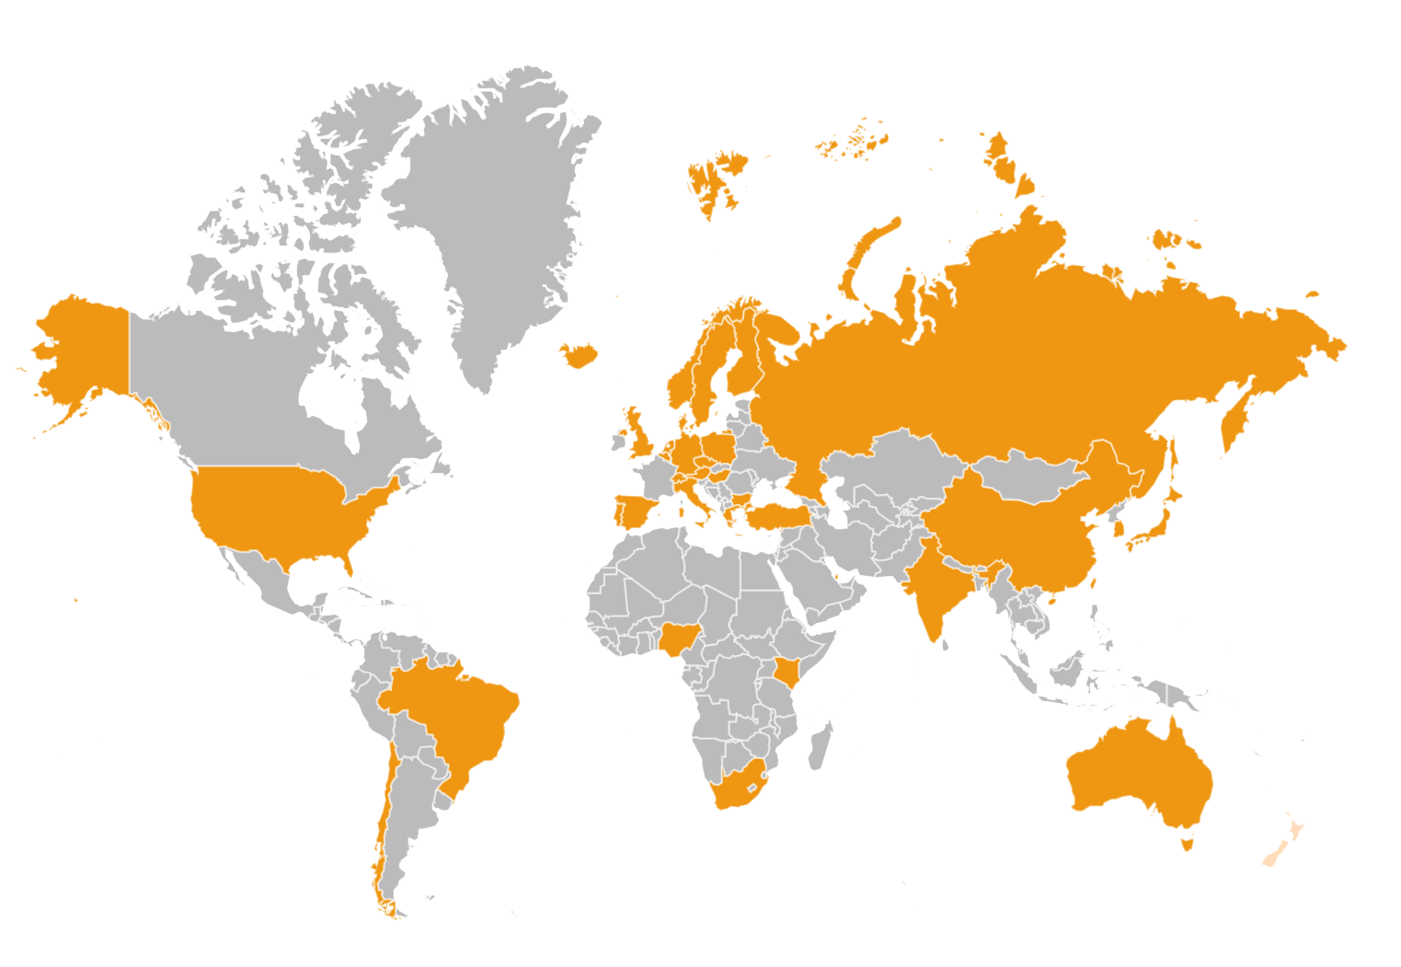
Open Access 2020 Initiative
https://oa2020.org/
Notes:
5 continents, 38 countries, 130 signatories
About the Max Planck Society
The Max Planck Society for the Advancement of Science (www.mpg.de/en) is an independent, non-profit research organization. Focusing on research fields that are particularly innovative, the 83 Max Planck Institutes conduct basic research in the service of the general public in the natural sciences, life sciences, social sciences, and the humanities. More than 15,000 studies by its researchers are published each year in internationally renowned scientific journals.

Slide 16
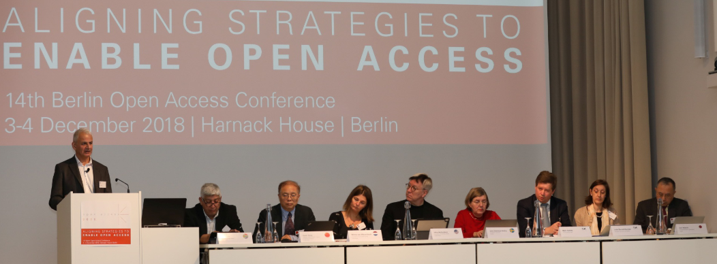
We need to face publishers at eye level
https://oa2020.org/b14-conference/
Notes:
What do researchers want?
They want to publish in their favorite journals
They want their work to be widely read and cited
They want the rights to re-use and share their work
They want to maintain their existing workflows
They want access to all existing journals
They want to make sure there are no publication barriers for anyone

Slide 17
Pareto principle works to our advantage
Costs
8 biggest publishers
70%
Smaller publishers
20%
Rest
10%
Number of publishers
Highest impact
www.vsnu.nl/openaccess

Slide 18

Transformative agreements
http://esac-initiative.org/
Notes:
Transformative agreements are those contracts negotiated between institutions (libraries, national and regional consortia) and publishers that transform the business model underlying scholarly journals from subscription to open access. As the vast majority of scholarly publishing and expenditure of any given institution tends to be concentrated in journals produced by a relatively small number of publishers, implementing transformative agreements with these publishers constitutes a high-impact strategy: many institutions and consortia find that by negotiating such agreements with fewer than 10 publishers, they can achieve immediate open access for the vast majority of their outputs.
They have a variety of configurations that reflect the diverse and fluid landscape of scholarly communication, starting with “offsetting” through to the recent “Publish & Read, or PAR” model, and more.
Agreements continue to evolve as they are increasingly adopted around the world and the body of evidence on their impact grows.
Put into practice, instead of paying fees for access to journals behind subscription paywalls, funds are repurposed to remunerate publishers for their editorial services associated with the open access publication of accepted articles.
In most models, fees are articulated at the article level or in proportion to the number of articles published, disbanding the lump-sums fees of subscriptions that are largely based on legacy print expenditures. The fundamental principles of transformative agreements include that they are temporary and transitional meaning that they are no end in itself but rather provide a framework in which a swift and irreversible shift away from the subscription model can be organized, affecting the financial and operational changes required for a fully open access publishing paradigm.
Requirements and guiding principles for the negotiations of transformative agreements have been published by libraries and library consortia around the world which demonstrates the ongoing effort of the comunity to shape the new busisness model and to improve transparency and efficiency. With our ESAC registry, we want to contribute to that process.

Slide 19


From individual journal subscriptions
to the Big Deal
Subscriptions
Notes:
Transformative agreements are those contracts negotiated between institutions (libraries, national and regional consortia) and publishers that transform the business model underlying scholarly journals from subscription to open access. As the vast majority of scholarly publishing and expenditure of any given institution tends to be concentrated in journals produced by a relatively small number of publishers, implementing transformative agreements with these publishers constitutes a high-impact strategy: many institutions and consortia find that by negotiating such agreements with fewer than 10 publishers, they can achieve immediate open access for the vast majority of their outputs.
They have a variety of configurations that reflect the diverse and fluid landscape of scholarly communication, starting with “offsetting” through to the recent “Publish & Read, or PAR” model, and more.
Agreements continue to evolve as they are increasingly adopted around the world and the body of evidence on their impact grows.
Put into practice, instead of paying fees for access to journals behind subscription paywalls, funds are repurposed to remunerate publishers for their editorial services associated with the open access publication of accepted articles.
In most models, fees are articulated at the article level or in proportion to the number of articles published, disbanding the lump-sums fees of subscriptions that are largely based on legacy print expenditures. The fundamental principles of transformative agreements include that they are temporary and transitional meaning that they are no end in itself but rather provide a framework in which a swift and irreversible shift away from the subscription model can be organized, affecting the financial and operational changes required for a fully open access publishing paradigm.
Requirements and guiding principles for the negotiations of transformative agreements have been published by libraries and library consortia around the world which demonstrates the ongoing effort of the comunity to shape the new busisness model and to improve transparency and efficiency. With our ESAC registry, we want to contribute to that process.

Slide 20
Hybrid publishing created a second, unmonitored revenue stream for publishers = double dipping
+
Subscriptions
Open access
Notes:
Transformative agreements are those contracts negotiated between institutions (libraries, national and regional consortia) and publishers that transform the business model underlying scholarly journals from subscription to open access. As the vast majority of scholarly publishing and expenditure of any given institution tends to be concentrated in journals produced by a relatively small number of publishers, implementing transformative agreements with these publishers constitutes a high-impact strategy: many institutions and consortia find that by negotiating such agreements with fewer than 10 publishers, they can achieve immediate open access for the vast majority of their outputs.
They have a variety of configurations that reflect the diverse and fluid landscape of scholarly communication, starting with “offsetting” through to the recent “Publish & Read, or PAR” model, and more.
Agreements continue to evolve as they are increasingly adopted around the world and the body of evidence on their impact grows.
Put into practice, instead of paying fees for access to journals behind subscription paywalls, funds are repurposed to remunerate publishers for their editorial services associated with the open access publication of accepted articles.
In most models, fees are articulated at the article level or in proportion to the number of articles published, disbanding the lump-sums fees of subscriptions that are largely based on legacy print expenditures. The fundamental principles of transformative agreements include that they are temporary and transitional meaning that they are no end in itself but rather provide a framework in which a swift and irreversible shift away from the subscription model can be organized, affecting the financial and operational changes required for a fully open access publishing paradigm.
Requirements and guiding principles for the negotiations of transformative agreements have been published by libraries and library consortia around the world which demonstrates the ongoing effort of the comunity to shape the new busisness model and to improve transparency and efficiency. With our ESAC registry, we want to contribute to that process.

Slide 21
Transformative agreements get control
over hybrid costs
Transformative Agreement
+
Subscriptions
Open access
http://esac-initiative.org/
Notes:
Transformative agreements are those contracts negotiated between institutions (libraries, national and regional consortia) and publishers that transform the business model underlying scholarly journals from subscription to open access. As the vast majority of scholarly publishing and expenditure of any given institution tends to be concentrated in journals produced by a relatively small number of publishers, implementing transformative agreements with these publishers constitutes a high-impact strategy: many institutions and consortia find that by negotiating such agreements with fewer than 10 publishers, they can achieve immediate open access for the vast majority of their outputs.
They have a variety of configurations that reflect the diverse and fluid landscape of scholarly communication, starting with “offsetting” through to the recent “Publish & Read, or PAR” model, and more.
Agreements continue to evolve as they are increasingly adopted around the world and the body of evidence on their impact grows.
Put into practice, instead of paying fees for access to journals behind subscription paywalls, funds are repurposed to remunerate publishers for their editorial services associated with the open access publication of accepted articles.
In most models, fees are articulated at the article level or in proportion to the number of articles published, disbanding the lump-sums fees of subscriptions that are largely based on legacy print expenditures. The fundamental principles of transformative agreements include that they are temporary and transitional meaning that they are no end in itself but rather provide a framework in which a swift and irreversible shift away from the subscription model can be organized, affecting the financial and operational changes required for a fully open access publishing paradigm.
Requirements and guiding principles for the negotiations of transformative agreements have been published by libraries and library consortia around the world which demonstrates the ongoing effort of the comunity to shape the new busisness model and to improve transparency and efficiency. With our ESAC registry, we want to contribute to that process.

Slide 22
Subscription funds are converted to open access publishing funds
Transformative Agreement
Subscriptions
Open access
Notes:
Transformative agreements are those contracts negotiated between institutions (libraries, national and regional consortia) and publishers that transform the business model underlying scholarly journals from subscription to open access. As the vast majority of scholarly publishing and expenditure of any given institution tends to be concentrated in journals produced by a relatively small number of publishers, implementing transformative agreements with these publishers constitutes a high-impact strategy: many institutions and consortia find that by negotiating such agreements with fewer than 10 publishers, they can achieve immediate open access for the vast majority of their outputs.
They have a variety of configurations that reflect the diverse and fluid landscape of scholarly communication, starting with “offsetting” through to the recent “Publish & Read, or PAR” model, and more.
Agreements continue to evolve as they are increasingly adopted around the world and the body of evidence on their impact grows.
Put into practice, instead of paying fees for access to journals behind subscription paywalls, funds are repurposed to remunerate publishers for their editorial services associated with the open access publication of accepted articles.
In most models, fees are articulated at the article level or in proportion to the number of articles published, disbanding the lump-sums fees of subscriptions that are largely based on legacy print expenditures. The fundamental principles of transformative agreements include that they are temporary and transitional meaning that they are no end in itself but rather provide a framework in which a swift and irreversible shift away from the subscription model can be organized, affecting the financial and operational changes required for a fully open access publishing paradigm.
Requirements and guiding principles for the negotiations of transformative agreements have been published by libraries and library consortia around the world which demonstrates the ongoing effort of the comunity to shape the new busisness model and to improve transparency and efficiency. With our ESAC registry, we want to contribute to that process.

Slide 23
Costs and workflows shift from package level to the individual article level
Transformative Agreement
Publication Fee
Reading Fee
Reading fee
OA Publishing
Notes:
Transformative agreements are those contracts negotiated between institutions (libraries, national and regional consortia) and publishers that transform the business model underlying scholarly journals from subscription to open access. As the vast majority of scholarly publishing and expenditure of any given institution tends to be concentrated in journals produced by a relatively small number of publishers, implementing transformative agreements with these publishers constitutes a high-impact strategy: many institutions and consortia find that by negotiating such agreements with fewer than 10 publishers, they can achieve immediate open access for the vast majority of their outputs.
They have a variety of configurations that reflect the diverse and fluid landscape of scholarly communication, starting with “offsetting” through to the recent “Publish & Read, or PAR” model, and more.
Agreements continue to evolve as they are increasingly adopted around the world and the body of evidence on their impact grows.
Put into practice, instead of paying fees for access to journals behind subscription paywalls, funds are repurposed to remunerate publishers for their editorial services associated with the open access publication of accepted articles.
In most models, fees are articulated at the article level or in proportion to the number of articles published, disbanding the lump-sums fees of subscriptions that are largely based on legacy print expenditures. The fundamental principles of transformative agreements include that they are temporary and transitional meaning that they are no end in itself but rather provide a framework in which a swift and irreversible shift away from the subscription model can be organized, affecting the financial and operational changes required for a fully open access publishing paradigm.
Requirements and guiding principles for the negotiations of transformative agreements have been published by libraries and library consortia around the world which demonstrates the ongoing effort of the comunity to shape the new busisness model and to improve transparency and efficiency. With our ESAC registry, we want to contribute to that process.

Slide 24
Reading fees are eliminated and costs are associated only with actual publication
Publication Fee
Publication Fee
Reading Fee
Reading Fee
Notes:
Transformative agreements are those contracts negotiated between institutions (libraries, national and regional consortia) and publishers that transform the business model underlying scholarly journals from subscription to open access. As the vast majority of scholarly publishing and expenditure of any given institution tends to be concentrated in journals produced by a relatively small number of publishers, implementing transformative agreements with these publishers constitutes a high-impact strategy: many institutions and consortia find that by negotiating such agreements with fewer than 10 publishers, they can achieve immediate open access for the vast majority of their outputs.
They have a variety of configurations that reflect the diverse and fluid landscape of scholarly communication, starting with “offsetting” through to the recent “Publish & Read, or PAR” model, and more.
Agreements continue to evolve as they are increasingly adopted around the world and the body of evidence on their impact grows.
Put into practice, instead of paying fees for access to journals behind subscription paywalls, funds are repurposed to remunerate publishers for their editorial services associated with the open access publication of accepted articles.
In most models, fees are articulated at the article level or in proportion to the number of articles published, disbanding the lump-sums fees of subscriptions that are largely based on legacy print expenditures. The fundamental principles of transformative agreements include that they are temporary and transitional meaning that they are no end in itself but rather provide a framework in which a swift and irreversible shift away from the subscription model can be organized, affecting the financial and operational changes required for a fully open access publishing paradigm.
Requirements and guiding principles for the negotiations of transformative agreements have been published by libraries and library consortia around the world which demonstrates the ongoing effort of the comunity to shape the new busisness model and to improve transparency and efficiency. With our ESAC registry, we want to contribute to that process.

Slide 25
Unbundled subscription costs allow money to flow where researchers choose to publish
Notes:
Transformative agreements are those contracts negotiated between institutions (libraries, national and regional consortia) and publishers that transform the business model underlying scholarly journals from subscription to open access. As the vast majority of scholarly publishing and expenditure of any given institution tends to be concentrated in journals produced by a relatively small number of publishers, implementing transformative agreements with these publishers constitutes a high-impact strategy: many institutions and consortia find that by negotiating such agreements with fewer than 10 publishers, they can achieve immediate open access for the vast majority of their outputs.
They have a variety of configurations that reflect the diverse and fluid landscape of scholarly communication, starting with “offsetting” through to the recent “Publish & Read, or PAR” model, and more.
Agreements continue to evolve as they are increasingly adopted around the world and the body of evidence on their impact grows.
Put into practice, instead of paying fees for access to journals behind subscription paywalls, funds are repurposed to remunerate publishers for their editorial services associated with the open access publication of accepted articles.
In most models, fees are articulated at the article level or in proportion to the number of articles published, disbanding the lump-sums fees of subscriptions that are largely based on legacy print expenditures. The fundamental principles of transformative agreements include that they are temporary and transitional meaning that they are no end in itself but rather provide a framework in which a swift and irreversible shift away from the subscription model can be organized, affecting the financial and operational changes required for a fully open access publishing paradigm.
Requirements and guiding principles for the negotiations of transformative agreements have been published by libraries and library consortia around the world which demonstrates the ongoing effort of the comunity to shape the new busisness model and to improve transparency and efficiency. With our ESAC registry, we want to contribute to that process.

Slide 26
Transparency and new market pressure enable cost differentiation according to service levels
Notes:
Transformative agreements are those contracts negotiated between institutions (libraries, national and regional consortia) and publishers that transform the business model underlying scholarly journals from subscription to open access. As the vast majority of scholarly publishing and expenditure of any given institution tends to be concentrated in journals produced by a relatively small number of publishers, implementing transformative agreements with these publishers constitutes a high-impact strategy: many institutions and consortia find that by negotiating such agreements with fewer than 10 publishers, they can achieve immediate open access for the vast majority of their outputs.
They have a variety of configurations that reflect the diverse and fluid landscape of scholarly communication, starting with “offsetting” through to the recent “Publish & Read, or PAR” model, and more.
Agreements continue to evolve as they are increasingly adopted around the world and the body of evidence on their impact grows.
Put into practice, instead of paying fees for access to journals behind subscription paywalls, funds are repurposed to remunerate publishers for their editorial services associated with the open access publication of accepted articles.
In most models, fees are articulated at the article level or in proportion to the number of articles published, disbanding the lump-sums fees of subscriptions that are largely based on legacy print expenditures. The fundamental principles of transformative agreements include that they are temporary and transitional meaning that they are no end in itself but rather provide a framework in which a swift and irreversible shift away from the subscription model can be organized, affecting the financial and operational changes required for a fully open access publishing paradigm.
Requirements and guiding principles for the negotiations of transformative agreements have been published by libraries and library consortia around the world which demonstrates the ongoing effort of the comunity to shape the new busisness model and to improve transparency and efficiency. With our ESAC registry, we want to contribute to that process.

Slide 27

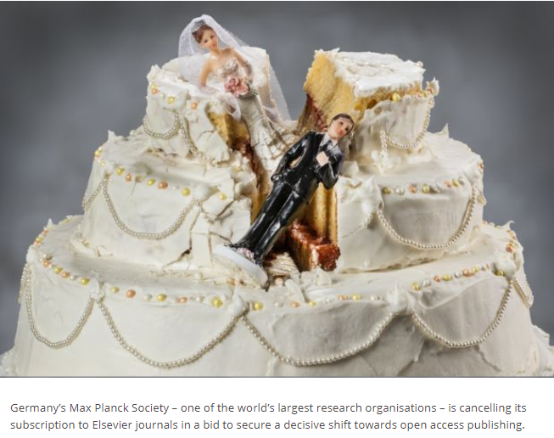

If necessary, step away from the table
https://www.timeshighereducation.com/news/max-planck-society-cancels-elsevier-subscription-over-open-access
Notes:
What UC faculty are saying:
“We all agree that open access is a good thing. It increases the visibility of our research, and it’s something the taxpayers deserve.”
— Karen Bales, psychology professor at UC Davis and chair of the campus Academic Senate research committee, as quoted in the Los Angeles Times
“We are interested in using text-mining to learn from the scientific literature. OA articles can be more readily obtained, analyzed, and curated. Those which are part of traditional subscriptions cannot be readily studied in this way.”
— Steven Brenner, a professor of plant & microbial biology at UC Berkeley, as quoted in The Daily Californian
“Every time a sensible person gets a simple explanation of the current system, the reaction is disbelief — that smart people have been doing this stupid thing for so long, and it’s been so, so expensive.”
— Don Moore, professor at the Haas School of Business at UC Berkeley, as quoted by the UC Berkeley Library
“At first they weren’t exploitatively priced. But the publishers noticed the demand was inelastic and they could get away with selling these things for much higher prices.”
— Ted Bergstrom, a professor of economics at UC Santa Barbara, as quoted in the Los Angeles Times
“Obviously we would prefer no disruption, but we have a network of colleagues and systems in place from which we can request articles. It’ll be an inconvenience, sure. But I think we understand the importance of what they’re trying to achieve.”
— Stephen Floor, assistant professor, department of cell and tissue biology, UC San Francisco, as quoted in Inside Higher Ed

Slide 28
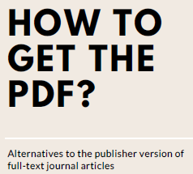
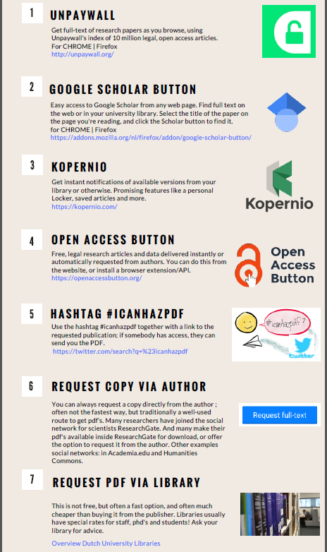
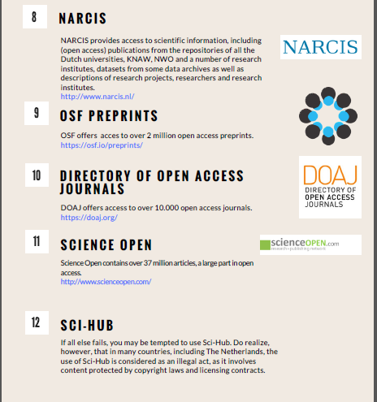
Stepping away from the table IS an option
http://www.openaccess.nl/sites/www.openaccess.nl/files/documenten/howtogettothepdf_march_2018.pdf

Slide 29
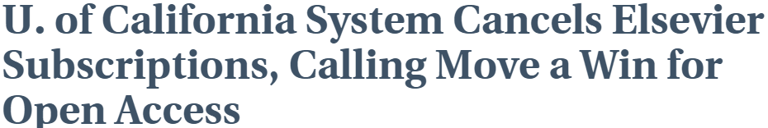
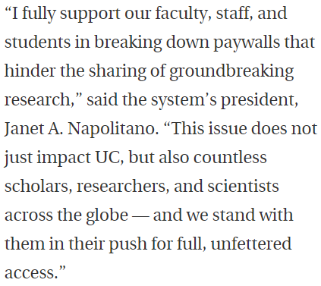
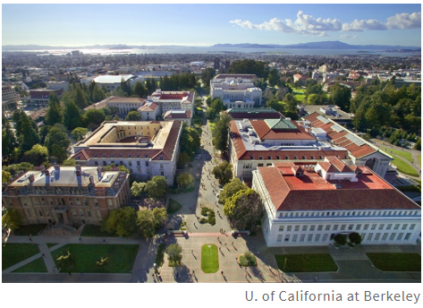
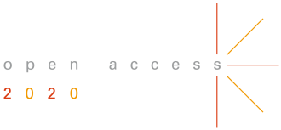
This just in!
Notes:
Despite months of contract negotiations, Elsevier was unwilling to meet UC’s key goal: securing universal open access to UC research while containing the rapidly escalating costs associated with for-profit journals.
In negotiating with Elsevier, UC aimed to accelerate the pace of scientific discovery by ensuring that research produced by UC’s 10 campuses — which accounts for nearly 10 percent of all U.S. publishing output — would be immediately available to the world, without cost to the reader. Under Elsevier’s proposed terms, the publisher would have charged UC authors large publishing fees on top of the university’s multi-million dollar subscription, resulting in much greater cost to the university and much higher profits for Elsevier.
“Knowledge should not be accessible only to those who can pay,” said Robert May, chair of UC’s faculty Academic Senate. “The quest for full open access is essential if we are to truly uphold the mission of this university.” The Academic Senate issued a statement today endorsing UC’s position.
Elsevier is the largest scholarly publisher in the world, disseminating about 18 percent of journal articles produced by UC faculty. The transformative model that UC faculty and libraries are championing would make it easier and more affordable for UC authors to publish in an open access environment.
“Make no mistake: The prices of scientific journals now are so high that not a single university in the U.S. — not the University of California, not Harvard, no institution — can afford to subscribe to them all,” said Jeffrey MacKie-Mason, university librarian and economics professor at UC Berkeley, and co-chair of UC’s negotiation team. “Publishing our scholarship behind a paywall deprives people of the access to and benefits of publicly funded research. That is terrible for society.”

Slide 30
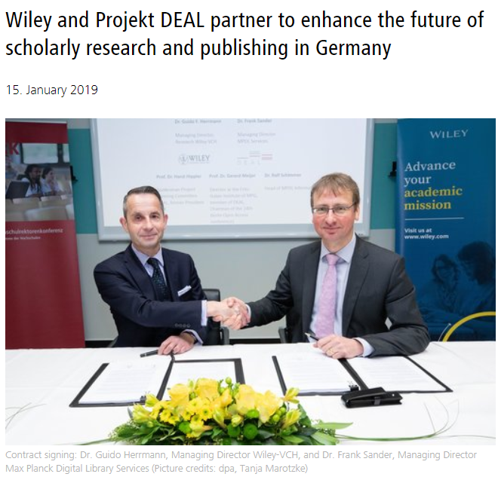
Cost-neutral transformation is possible
“All German research articles in Wiley journals to be published open access under new transformative agreement”
https://www.hrk.de/press/press-releases/press-release/meldung/wiley-and-projekt-deal-partner-to-enhance-the-future-of-scholarly-research-and-publishing-in-germany/
Notes:
~10.000 articles a year complete and immediate open access
Authors are guaranteed academic freedom
Authors retain copyright, can use and re-use their work
Scholars and society learn from and build on the latest research
Departure from the subscription logic
Costs are transparent and transactions at the article level
The PAR fee itself is a key transitional element in that it builds a bridge for the previous total subscription expenditure of German institutions to be shifted to support the country’s research output under a realistic publication scenario while at the same time minimizing the risk of massive financial disruption for both parties. The PAR fee of this contract is unique to the German setting and constitutes a context-specific balance between a given historic situation and an anticipated future objective. Others may find inspiration in this principle but should not be preoccupied with the figure as such, as the starting point will be different in other contexts.
Operational compliance with open access workflows
Forward-looking processes and systems
Prepare for transition at scale
To clarify and avoid misunderstandings, we have summarized below the key points to the agreement between Wiley and Project DEAL, which we can publish before February 15, 2019:
1. Continuous access to Wiley's entire portfolio of electronic journals ("perpetual access") for all participating institutions. These are currently about 1,700 titles (subscription journals, as well as original open access journals).
2. Permanent archive rights for all participating institutions to the entire journal portfolio back to the year of publication 1997.
3. Publishing articles in Open Access to all Submitting Corresponding Authors from eligible institutions in Wiley's journals (both in the original open access journals and in the subscription titles), usually under a CC-BY license. We assume a volume of nearly 10,000 articles per year.
4. Agreement on a fair and sustainable Publish & Read cost model. The total price is calculated annually from the agreed Publish & Read fee (in short: PAR fee) and the number of articles published annually in accordance with No. 3 (based on subscription titles). This covers both the publication of the above-mentioned articles ("publish") in Open Access and the reading access to the entire electronic portfolio of subscription periodicals ("read") for the period from 2019 to 2021. There are no additional costs for the reading access. The PAR fee is not equivalent to a hybrid APC (article processing charge).
A key figure-based individual participation fee is calculated for the participant facilities, which is based on the previous license payments and the publication volume. The individual scientists do not incur any separate costs.
Wiley's Gold Open Access Journals will be granted a 20% discount on APC list prices. The billing of the APCs is also done centrally by the participating institution.

Slide 31

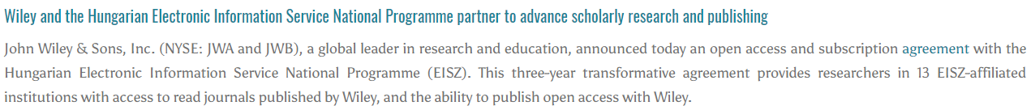
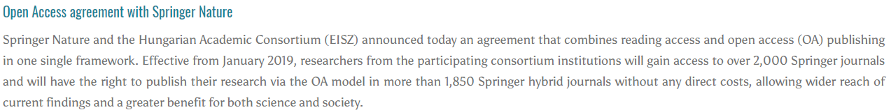
And it is possible everywhere
https://http://eisz.mtak.hu/index.php/en/
Notes:
~10.000 articles a year complete and immediate open access
Authors are guaranteed academic freedom
Authors retain copyright, can use and re-use their work
Scholars and society learn from and build on the latest research
Departure from the subscription logic
Costs are transparent and transactions at the article level
The PAR fee itself is a key transitional element in that it builds a bridge for the previous total subscription expenditure of German institutions to be shifted to support the country’s research output under a realistic publication scenario while at the same time minimizing the risk of massive financial disruption for both parties. The PAR fee of this contract is unique to the German setting and constitutes a context-specific balance between a given historic situation and an anticipated future objective. Others may find inspiration in this principle but should not be preoccupied with the figure as such, as the starting point will be different in other contexts.
Operational compliance with open access workflows
Forward-looking processes and systems
Prepare for transition at scale
To clarify and avoid misunderstandings, we have summarized below the key points to the agreement between Wiley and Project DEAL, which we can publish before February 15, 2019:
1. Continuous access to Wiley's entire portfolio of electronic journals ("perpetual access") for all participating institutions. These are currently about 1,700 titles (subscription journals, as well as original open access journals).
2. Permanent archive rights for all participating institutions to the entire journal portfolio back to the year of publication 1997.
3. Publishing articles in Open Access to all Submitting Corresponding Authors from eligible institutions in Wiley's journals (both in the original open access journals and in the subscription titles), usually under a CC-BY license. We assume a volume of nearly 10,000 articles per year.
4. Agreement on a fair and sustainable Publish & Read cost model. The total price is calculated annually from the agreed Publish & Read fee (in short: PAR fee) and the number of articles published annually in accordance with No. 3 (based on subscription titles). This covers both the publication of the above-mentioned articles ("publish") in Open Access and the reading access to the entire electronic portfolio of subscription periodicals ("read") for the period from 2019 to 2021. There are no additional costs for the reading access. The PAR fee is not equivalent to a hybrid APC (article processing charge).
A key figure-based individual participation fee is calculated for the participant facilities, which is based on the previous license payments and the publication volume. The individual scientists do not incur any separate costs.
Wiley's Gold Open Access Journals will be granted a 20% discount on APC list prices. The billing of the APCs is also done centrally by the participating institution.

Slide 32
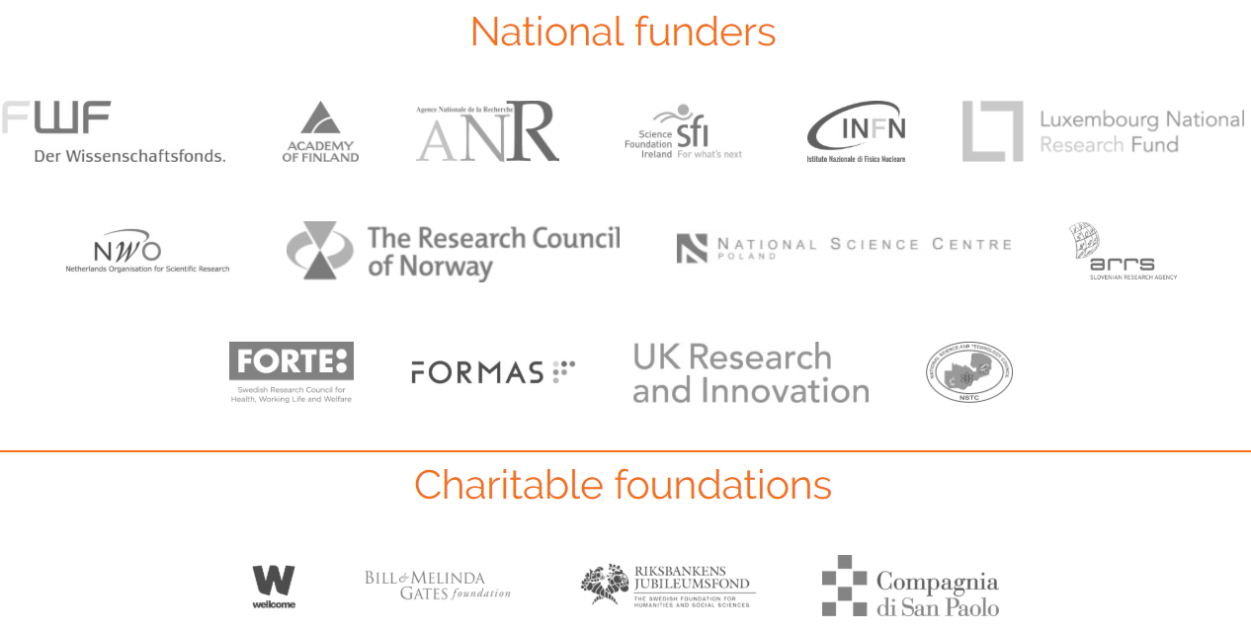
Plan S and funders are getting into the act!
Notes:
A publication can be Plan S compliant either
in a pure OA journal/platform, or
on a OA repository, or
in a hybrid OA journal under a tansformative agreement.
For each of these options you can start with the corresponding node and follow all edges to see the needed requirements.
For example: A publication in a OA repository is Plan S compliant if the main requirements are fulfilled, the repository fulfills the connected metadata, organizational, and technical requirements, and moreover the corresponding journal/venue fulfills its connected metadata, technical, and self-archiving policy requirements. Alternatively, one can look at the colors and in this example needs to fulfill all green and blue requirements.
Contributors: Philipp Zumstein
Date created: 2019-01-03 05:38 PM | Last Updated: 2019-01-12 02:57 PM
Identifier: DOI 10.17605/OSF.IO/DY6V7
Category: Project
Description: This diagram shows requirements for Plan S compliance in one page.

Slide 33
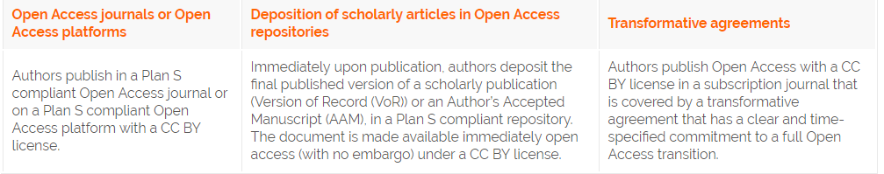
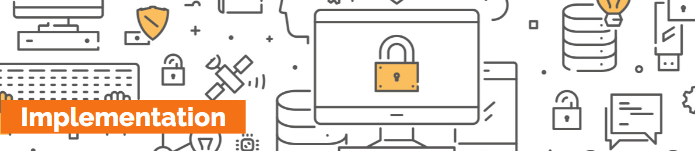
How to comply with Plan S?
https://www.coalition-s.org/implementation/
Notes:
A publication can be Plan S compliant either
in a pure OA journal/platform, or
on a OA repository, or
in a hybrid OA journal under a tansformative agreement.
For each of these options you can start with the corresponding node and follow all edges to see the needed requirements.
For example: A publication in a OA repository is Plan S compliant if the main requirements are fulfilled, the repository fulfills the connected metadata, organizational, and technical requirements, and moreover the corresponding journal/venue fulfills its connected metadata, technical, and self-archiving policy requirements. Alternatively, one can look at the colors and in this example needs to fulfill all green and blue requirements.
Contributors: Philipp Zumstein
Date created: 2019-01-03 05:38 PM | Last Updated: 2019-01-12 02:57 PM
Identifier: DOI 10.17605/OSF.IO/DY6V7
Category: Project
Description: This diagram shows requirements for Plan S compliance in one page.

Slide 34
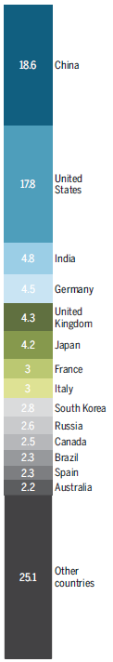
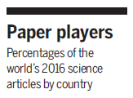
How long will it take to achieve open access on a large scale?
That depends on us!
https://www.sciencemag.org/news/2019/01/will-world-embrace-plan-s-radical-proposal-mandate-open-access-science-papers
Notes:
Researchers obtain grant funding, usually from federal agencies
Researchers use those monies to pay for labs, equipment, grad students, etc. to carry out their research
Researchers write up the results of their research and then seek out a journal to publish it in.
Publishers accept articles for publication, but require the authors to sign over their copyright, meaning that the journal now owns the article.
Publishers sell back the journals to libraries at exorbitant prices
Libraries buy the journals because they are essential for research being conducted by faculty and students.
Neither authors nor peer reviewers are paid for their services.

Slide 35
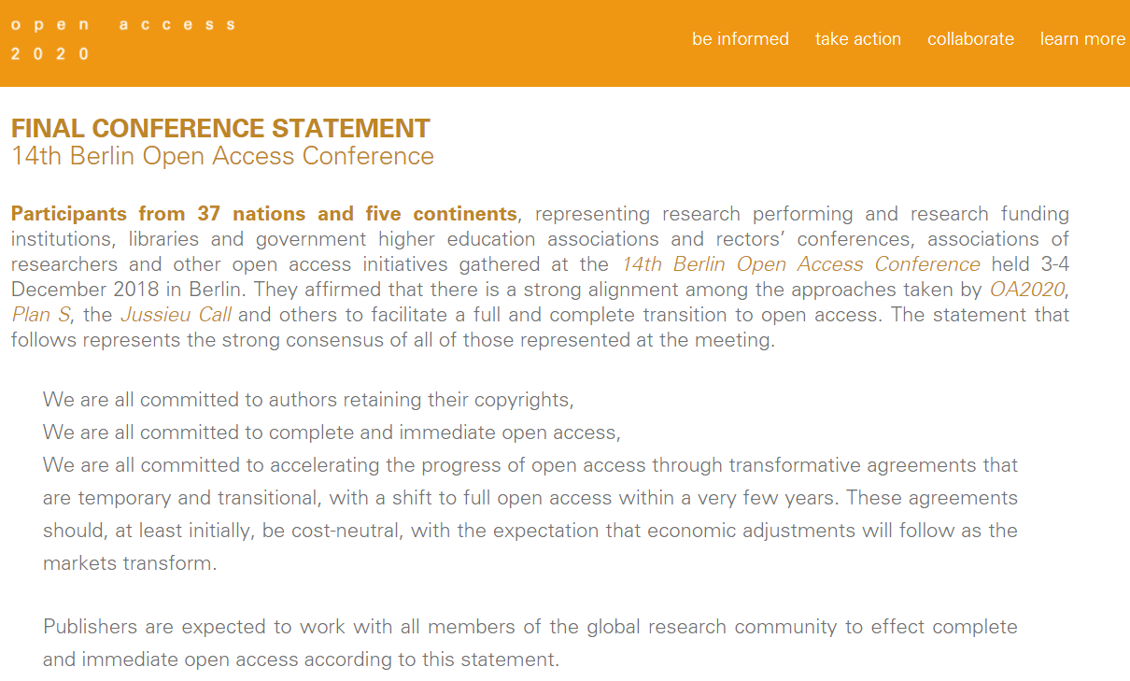
Global consensus via OA2020
https://oa2020.org/b14-conference/
Notes:
What do researchers want?
They want to publish in their favorite journals
They want their work to be widely read and cited
They want the rights to re-use and share their work
They want to maintain their existing workflows
They want access to all existing journals
They want to make sure there are no publication barriers for anyone

Slide 36
What should librarians do?
Sign the OA2020 Expression of Interest in the Large Scale Implementation of Open Access to Scholarly Journals
https://oa2020.org/mission/
Engage with the OA2020 community to share and learn strategies and best practice for addressing publishers
https://oa2020.org/learn_more/#promote
Establish workflows to collect data on Article Processing Charges and share this data with the OpenAPC Initiative
https://treemaps.intact-project.org/
Discuss OA2020 with your senior leadership at the University and Government level
https://oa2020.org/Executive-Summary.pdf
Notes:
to this google sheets document prepared by Bianca Kramer of Utrecht University.
Using a novel method she has made some estimates on the possible impact of Plan S. Using Dimensions and Unpaywall she has calculated the amount of publications stemming from funding of all Plan S subscribers and % of OA (full, hybrid, bronze). of course aware of problems using WoS

Slide 37
Resources
Transformative agreements (ESAC Initiative)
http://esac-initiative.org/
Data on Article Processing Charges (OpenAPC Initiative)
https://treemaps.intact-project.org/
Open Access 2020 Resources
https://oa2020.org/learn_more/#gain
Open Access 2020 Community listserv
contact@oa2020.org

Slide 38
Aligning our strategies
We can break the subscription system so our money can follow scholars, not publishers.

Slide 39
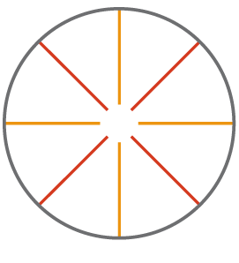
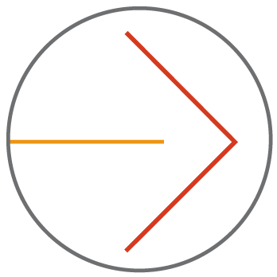
Thank you!
Participate in OA2020
Accelerate the transition
Colleen Campbell
Open Access 2020 Initiative
Max Planck Digital Library
campbell@mpdl.mpg.de
@ColleenCampbe11
https://oa2020.org

