Slide 1
Marco Gnjatovic Director of Sales Europe & Latin America

Slide 2
CONTENT
ACQUISITION MODELS
USER EXPERIENCE
LIBRARY WORKFLOW

Slide 3
Content – EBSCO eBooks
1 Million titles ….and counting
1,000+ parent publishers
2,000+ imprints
330,000+ EPUB titles
adding 16.000 titles per month
focus on adding content in non-English languages
global licensing initiative

Slide 4
Sample Publishers
Taylor & Francis Routledge
John Wiley & Sons
Wolters Kluwer (LWW)
Palgrave Macmillan
Pearson Education Ltd.
Edward Elgar Publishing
Springer Science & Business
CRC Press
I.B. Tauris
Elsevier
IGI Global
Greenwood Publishing Group
Springer Publishing
de Gruyter Publishing
Over 100 University Presses, including:
Oxford University Press
Cambridge University Press
MIT Press

Slide 5
EBSCO Publisher Relations
CONTENT
32 employees in Content Licensing
19 of them International
~ 100* new Publishers signed per year
acquire DRM-free rights
include new Business models in the contract
react quickly on customers content requests

Slide 6
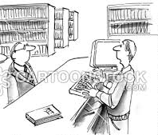
Sure, 1 User, Unlimited, loan, Subscription, PDA, EBS, ...
An eBook please
?
?
?
?
Notes:
eBook Models are complicated to understand for Libraries.
EBSCO is trying to achive rights for ALL available Business models in order to give Libraries flexibility for eBook purchase

Slide 7
Acquisition Models
Purchase, perpetual ownership (1U, 3U, UU)
Subscription Collections
PDA, Short-term-Loan
EBSCO supports all models in the market
Explore new models based on customer feedback (e.g. Evidence-based-Selection)
DRM-free Project

Slide 8
Acquisition models by numbers
 | Amount | Percentage
Single User Access (1B1U) | 1.000.000 | 100,00%
3 Concurrent Users (1B3U) | 783.577 | 78,57%
Unlimited concurrent Users (1BUU) | 612.953 | 61,29%
Available through eBook Subscriptions (1BUU) | 363.024 | 36,30%
Available through PDA/DDA | 664.254 | 66,42%
Available through STL/Loan | 547.196 | 54,19%
EBSCOhost Collection Manager – May 2017

Slide 9
Acquisition Model Trending
Other
Purchase
Subscription
specialized needs
e.g. Short-term-loan for a specific project
Purchase
Individual titles, Subject collections, PDA
focus on Frontlist
Foundational collection
Maximum access
easy to manage
best ROI

Slide 10
eBook Subscription Collections
Large predefined collections of unlimited user titles
Subscription rate is small fraction of purchase price (yearly flat-rate)
Academic
Business
History
Religion
Clinical
Education
Nursing
University Press
Arabic

Slide 11
Example: eBook Academic Collection
155,000+ titles
Over 515+ parent publishers, including Taylor & Francis, Wiley, Elsevier, Brill, Bloomsbury, and more
Over 58,000+ titles from more than 140 university presses, including Oxford, Cambridge, MIT, and more
~5000 new titles added each half year at no additional cost
ALL Titles with Unlimited Access!

Slide 12
LC Class Coverage
SUBJECT | TITLES | 1U PURCHASE PRICE
Agriculture | 1,374 | $101,746
Auxiliary sciences of history | 737 | $62,945
Bibliography. Library Science | 1,431 | $125,178
Education | 5,352 | $415,453
Fine Arts | 2,428 | $181,992
General Works | 164 | $16,278
Geography, Anthropology, Recreation | 4,216 | $342,643
History of the Americas | 6,487 | $366,869
Language and Literature | 27,701 | $2,608,221
Law | 6,173 | $646,571
Medicine | 11,066 | $1,090,968
Military Science | 1,259 | $77,617
Music and Books on Music | 2,227 | $157,754
Naval Science | 227 | $15,944
Philosophy, Psychology, Religion | 14,792 | $1,368,657
Political Science | 5,547 | $482,975
Science | 14,785 | $1,853,010
Social Sciences | 26,390 | $2,191,989
Technology | 9,770 | $1,271,004
World History | 8,274 | $665,586
Total | 150,400 | $14,043,400

Slide 13
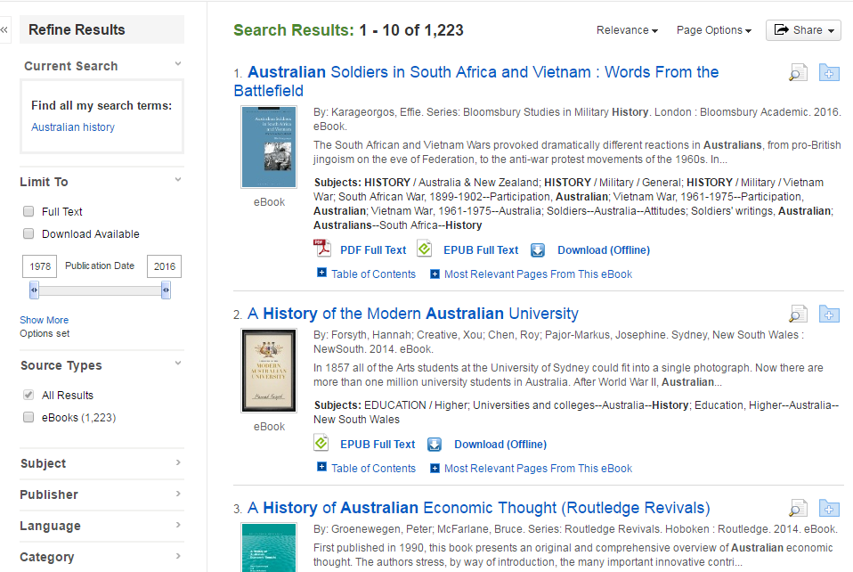
USER EXPERIENCE on EBSCOHOST

Slide 14
New Viewer

Slide 15
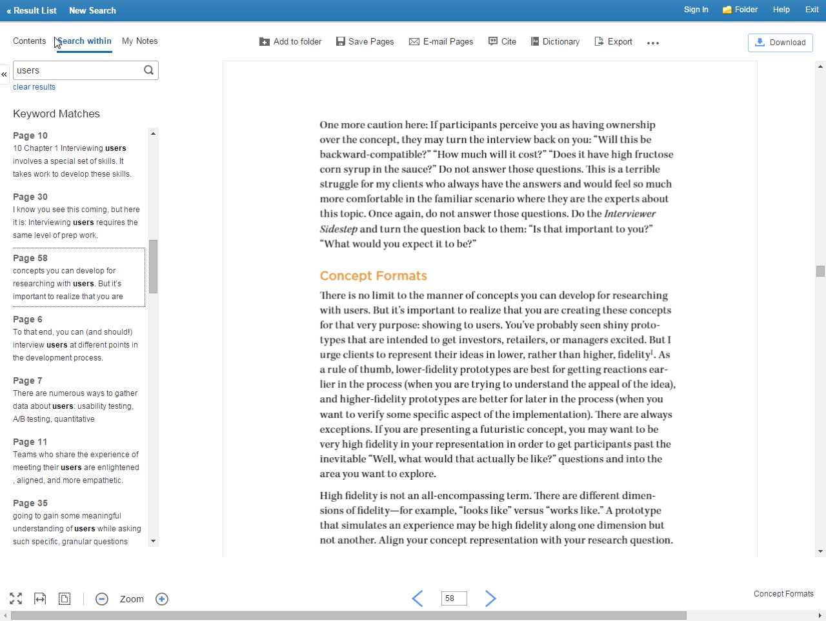
Search Within
Results

Slide 16
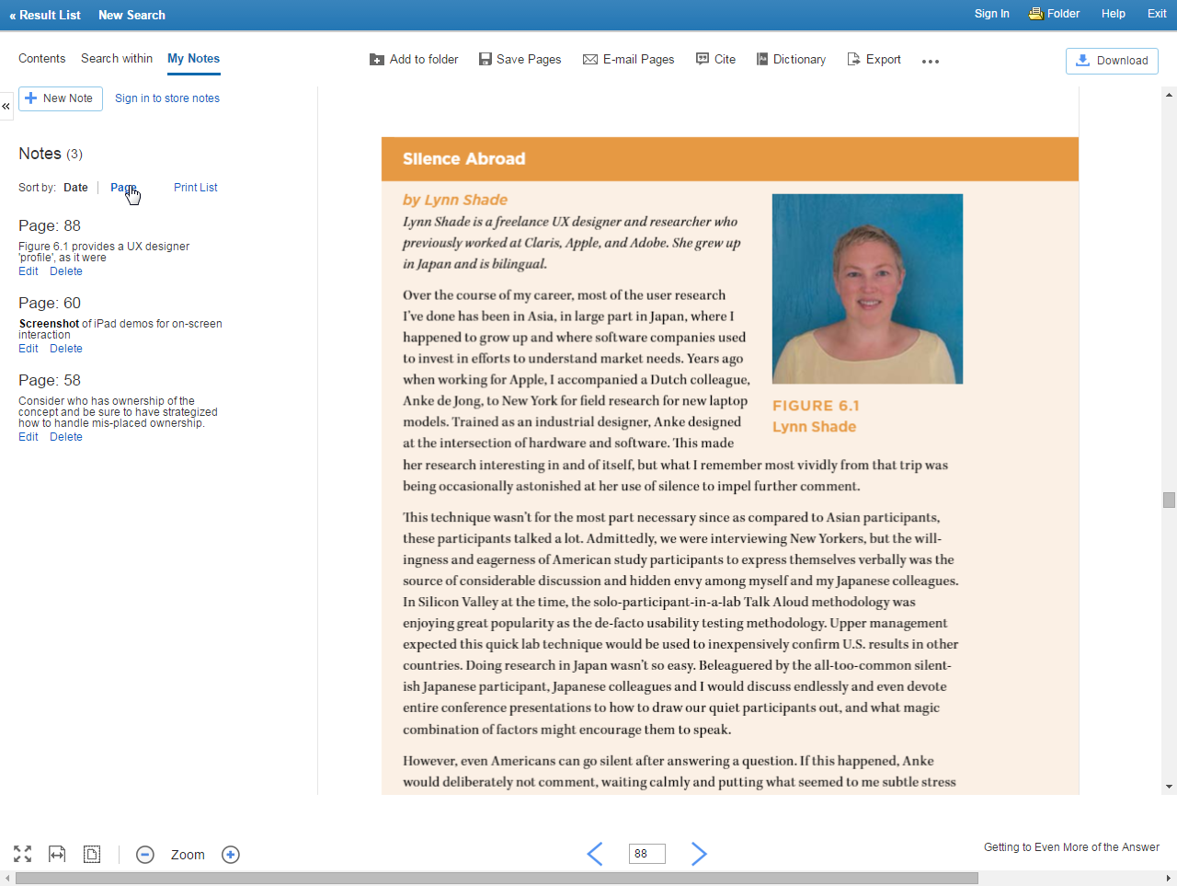
My Notes
Panel

Slide 17
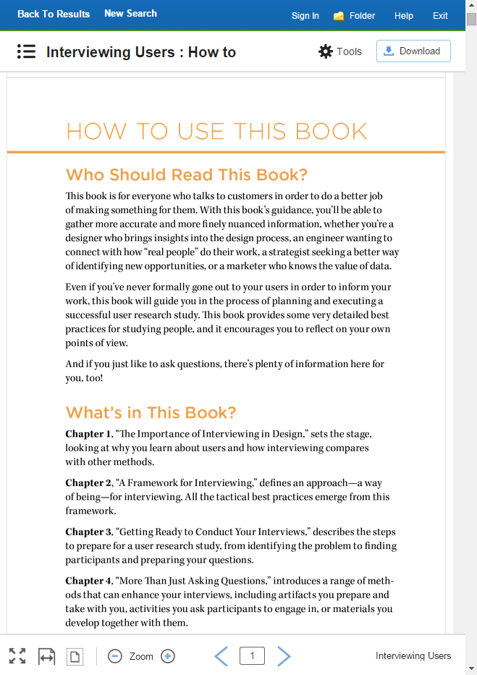
Tablet View

Slide 18
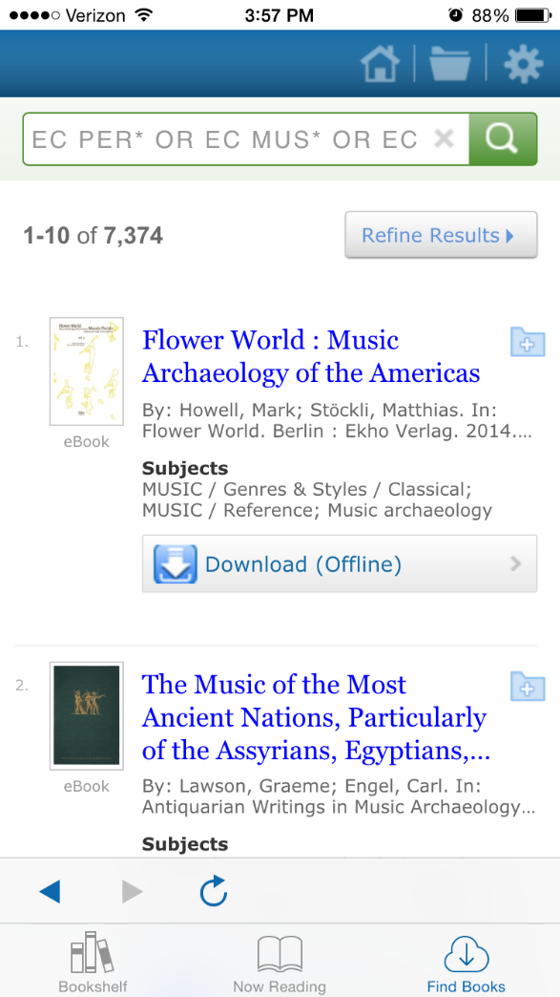
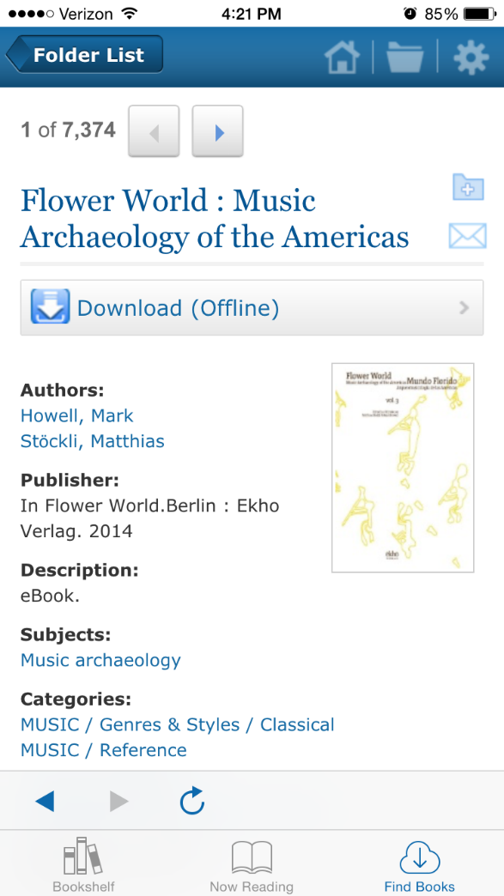
USER EXPERIENCE
Results List & Detailed Record

Slide 19
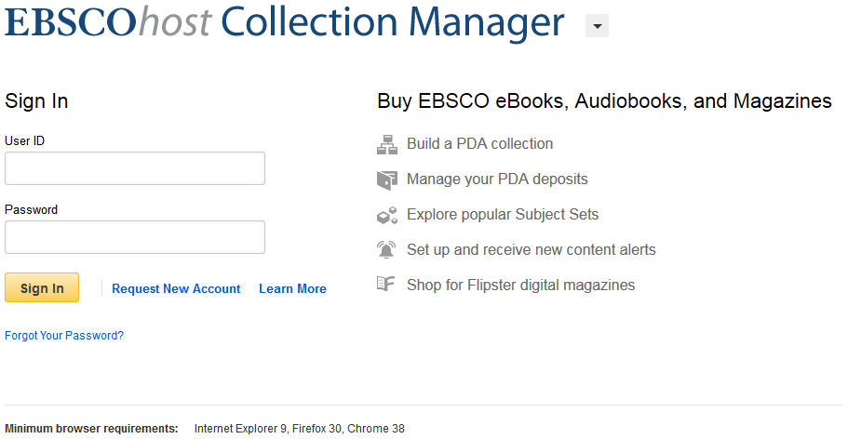
get Login Values from your local EBSCO Representative!
Search, Find and Order eBooks with ECM
http://ecm.ebscohost.com
Paste slide image here

Slide 20
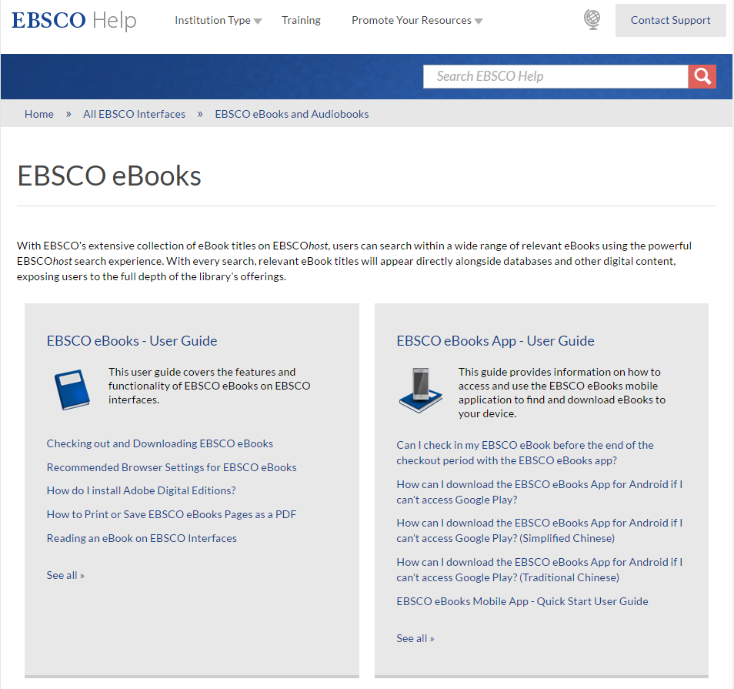
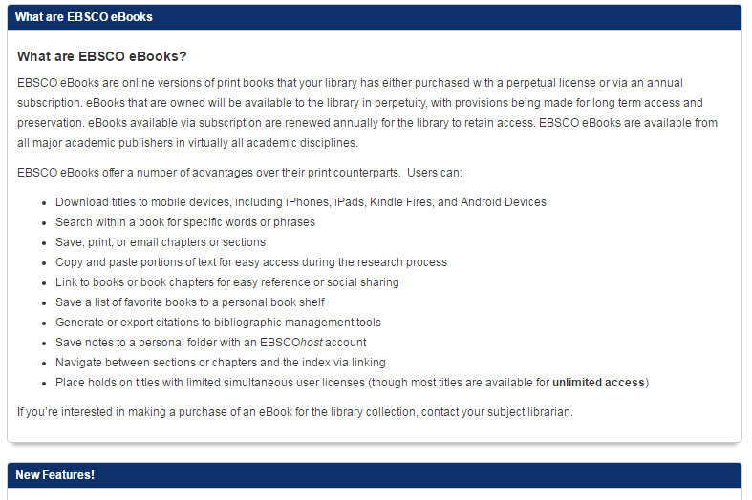
Training & Support Resources
http://help.ebsco.com
http://ebsco.libguides.com/ebooks
Visit the Site »
Visit the Site »

Slide 21
EBSCO eBooks Summary
CONTENT
most content at any eBook Aggregator (1 Mio.)
support all available Business models
eBook access in Minutes
license more Publishers and International eBooks
plan to offer DRM-free eBooks by 2018
EBSCO offers the complete Package: Print, Electronic, Publisher Platforms and Aggregators

Slide 22
Thank you
Marco Gnjatovic | Director of Sales eBooks
mgnjatovic@ebsco.com

